Slide 1
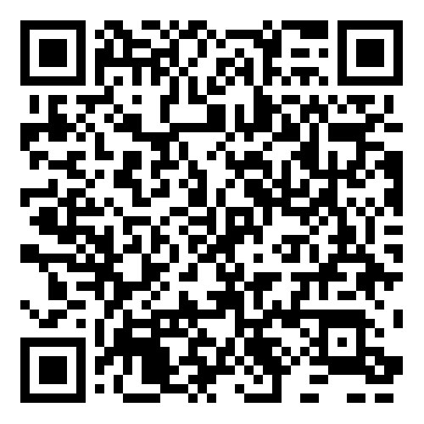
How Can You Get Involved?
Explore a new video series from the Shining Waters Regional Council’s Nominations Committee!
Learn about the work of our committees and commissions
Hear directly from people currently serving
Discover where your gifts might be a good fit
Watch now and see how you can get involved in the life and mission of the wider United Church of Canada.
Questions or want to connect to learn more?
Contact: Jody Maltby – jmaltby@united-church.ca
See our website here:
https://shiningwatersregionalcouncil.ca/
about/getinvolved/#video-series

