Slide 1
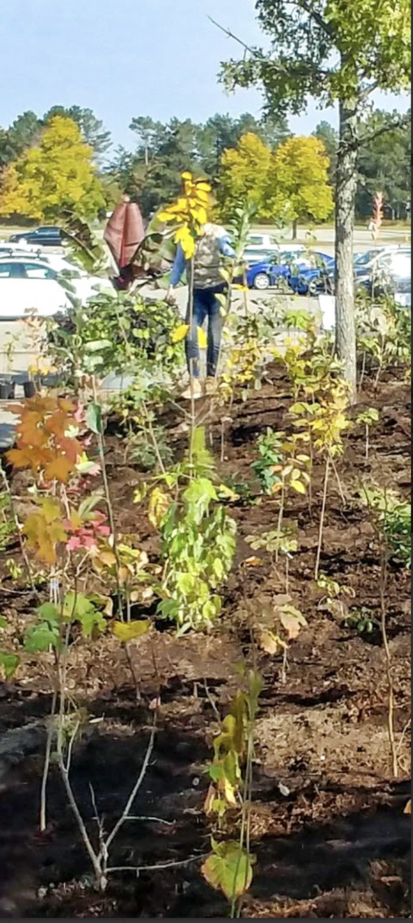
Committed to
Climate Action:
Greening Grounds and Greenbelts
Photo Credit: National Mini-Forest Pilot - Green Communities Canada
March 9, 2024
Social and Ecological Justice Commission

Slide 2
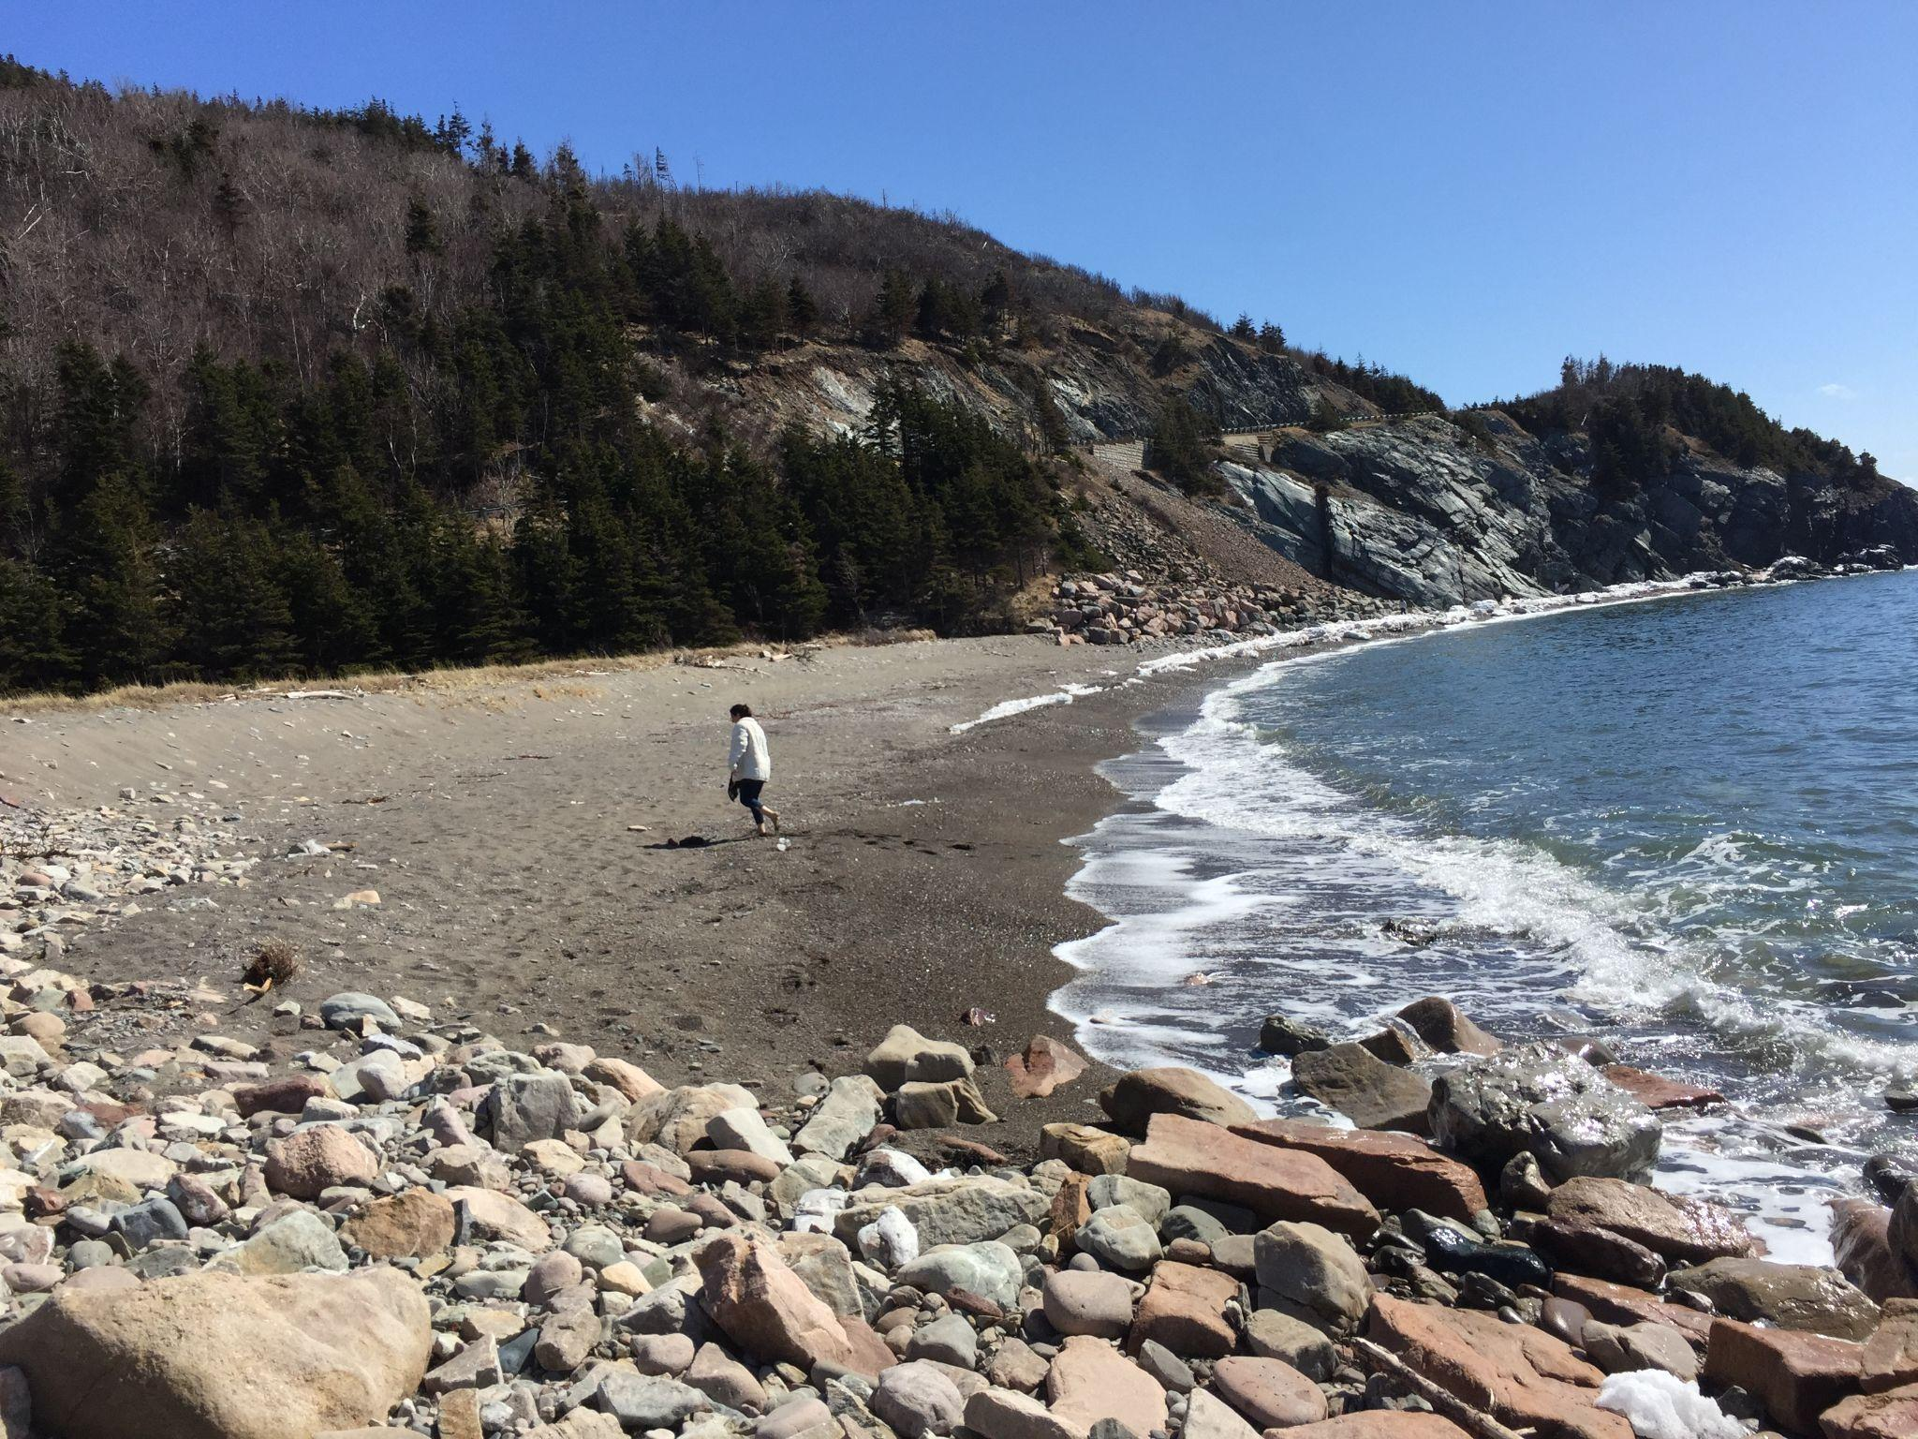
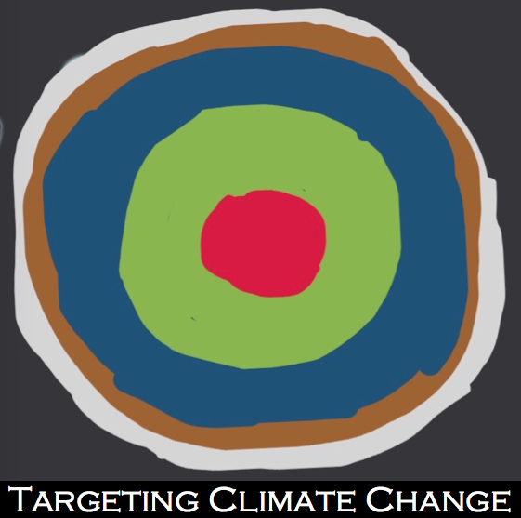
Boozhoo
Bienvenue
Welcome
A visual symbol indicates to others that climate action is happening.
This symbol indicates that the user is working with the air, soil, and water to increase the life by decreasing the heat. Feel free to use it!
Notes:
Welcome everyone. Thank you for coming. We are the Ecological Subcommittee of the Social and Ecological Justice Commision for the Shining Waters Region of the United Church of Canada. But what we are here for is to find ways for faith communities to inform and mobilize their communities to address the climate crisis. Here is Susan Eagle, our chair.
Susan speaks

Slide 3
Sustainability of the Land
Think about who walked here before us….
Chippewas of Rama First Nations and other Anishinabek Nations,
Huron-Wendat,
Mississaugas of the Credit River First Nation.
Think about the processes that occurred to uproot those peoples…
Toronto Purchase
Williams Treaties
Think about what we need to do for reconciliation…
The Chippewas of Rama First Nation have been known as a caring, sharing people throughout history.
Our Chippewa territory has been called ‘the gathering place’ where travellers rested before continuing on their journey, where great meetings were held and important agreements signed.
We invite you to learn more about our community, whose pride in Ojibwe traditions and restoring traditional ecological knowledge are at the forefront of community visioning.
Notes:
There is clear evidence that a sustainable future will be equitable and inclusive - for all life forms. We are aware that this has not been how we have acted in the past, in Canada, towards those who were indigenous to this land. For me, those are … I am aware of the processes that occurred to uproot them (but fortunately, they still have an enduring presence here). For me those are… and the Indian Act and many other injuries along the way. Like they did, we must learn to Think about how to reconcile and the land, the soil, the water… Each time I do a land acknowledgement, I take time to do a little research into the nations around me. From the earliest of times, our people have been entrepreneurs, artisans, craftsmen, hunters and fishermen. We later operated as guides throughout the area for tourists, marketed crafts and produce. … Our ultimate goal is to protect the lands, resources and water, to ensure a healthy environment for this and future generations. This stands alongside progressive programs, economic development initiatives and member services.
Acknowledging that you are a guest on our territory shows us that you respect our traditional rights and our responsibility for this land. It acknowledges that you understand that this land was taken from us and that the treaties we have signed must be honoured.
The Rama Country Market is open from 6:00 a.m. to 11:00 p.m. daily.

Slide 4
Agenda for the Afternoon
1:00 - 1:05 Welcome and Introduction
1:05 - 1:10 Biodiversity Crisis, Don Ford, SEJC (spoke at end of meeting)
1:10 - 1:30 Margaret Prophet, Executive Director of the Simcoe County Greenbelt Coalition
1:30 - 1:35 Franz Hartmann, Coordinator of the Alliance for a Liveable Ontario
1:35 - 1:45 Erin Alladin, Community Permaculture Project at Kimbourne Park United Church (unable to attend)
1:45 - 2:20 Networking
2:20 - 2:30 Next Steps and Closing
Notes:
We will be hearing shortly from Margaret Prophet, Executive Director Simcoe County Greenbelt Coalition and Franz Hartmann, Coordinator of the Alliance for a Liveable Ontario to help us better understand what is happening on our Greenbelt. Then Erin Alladin (AL-uh-din), who is working on the Community Permaculture Project at Kimbourne Park United Church will share about that project.
Most of the afternoon will be about listening to your voices as we work together to share and explore solutions to our biodiversity crisis.

Slide 5
February - August, 2022
44th General Council Adopts Climate Objective
climate strategy that accelerates reductions towards the goal of an 80% decrease in emissions by 2030
with a commitment to measure, report and adjust based on learnings.
Notes:
General Council Executive adopted the following strategic climate objective:
amplify and integrate current initiatives in a bold, hopeful denominational climate strategy that accelerates reductions towards the goal of an 80% decrease in emissions by 2030; with a commitment to measure, report and adjust based on learnings.
This has seemed extreme to many. But, we have been listening closely to evidence from scientists studying the climate crisis and it is not extreme. The synthesis Report of the IPCC’s 6th assessment report released in September 2022, indicates that with the policies in place we are projected to reach 2.8 degrees warming and based on past ability to implement policies we are likely to destined to reach 3.2 degrees. I see no reason to doubt these. The descriptions in this article of what those scenarios look like is catatclysmic (a word used by the United Nations report). What I also found interesting in that article is that the second barrier to changing these statistics is “A lack of private sector and citizen engagement’. I believe that faith communities are uniquely poised to do something about that aspect - there is an urgent need to do this now so that policies change before 2030. We do not have until 2050. Recently, we have news that we have passed the 1.5º C warming (from pre-industrial levels) as a global average for over 2 years. Taking their look at this period a step further, Copernicus also added that "the average global temperature for the 12 months to January 2024 is estimated to be 1.52°C above the 1850-1900 level. The average over the thirteen months from the beginning of 2023 is 1.50°C above the 1850-1900 level."
"This does not mean that the world has exceeded the lower-level target of 1.5° Celsius above the pre-industrial era referred to in the Paris Agreement on Climate Change," the WMO cautioned. "The Paris Agreement refers to long-term warming over many years rather than monthly or annual exceedances." https://www.msn.com/en-ca/weather/topstories/earth-just-experienced-its-hottest-12-months-in-recorded-history/ar-BB1iMo1z
Links to the articles I referred to will be in the speaker notes for this slide when the slideshow is accessed on the Shining Waters Ecological Justice webpage after this event.

Slide 6
Faith Communities
Working on the Biodiversity and Climate Crises
Shining Waters Region -
What are the ways faith communities are the force that moves the private sector and citizens in the ongoing biosphere crises?
An ask:
Build an interfaith movement to inform and support a local sustainable community.
Notes:
Our goal is to explore here: … We will be asking that…

Slide 7
Biodiversity - Don Ford
Note: his slides may be added separately to the website at a later time.
Notes:
I now turn it over to Don Ford, a member of the Ecological Sub-committee of the Social and Ecological Justice Commission. He will help us better understand the current Biodiversity Crisis and what is being done and should be done to ameliorate it.

Slide 8
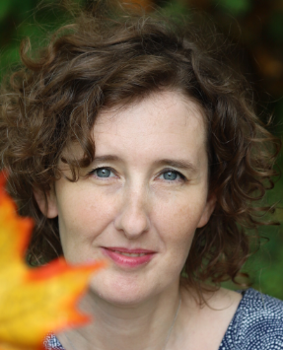
Margaret Prophet - Simcoe County Greenbelt Coalition
BEd in Adult Education and a BA of Psychology from Brock University
Past Director of Communications and Operations in the corporate education sector
Past volunteer Communications Director for the Midhurst Ratepayers’ Association
Founded the Simcoe County Greenbelt Coalition with Sandy Agnew and 15 like-minded groups
Notes:
We will be hearing shortly from Margaret Prophet, Executive Director Simcoe County Greenbelt Coalition and Franz Hartmann, Coordinator of the Alliance for a Liveable Ontario to help us better understand what is happening on our Greenbelt. Then Erin Alladin, who is working on the Community Permaculture Project at Kimbourne Park United Church will share about that project.
Most of the afternoon will be about listening to your voices as we work together to share and explore solutions to our biodiversity crisis.
Margaret has a Bachelor of Education, specialized in Adult Education and a BA of Psychology from Brock University. She worked in the corporate education sector for 7 years at a Director level including as Director of Communications and Operations. Margaret decided to pursue her love of community and environment by volunteering for her local ratepayers association (Midhurst Ratepayers’ Association) while taking time to raise her family. This lead to her getting involved with complex land-use planning matters and municipal politics as the Communications Director for the association. Her work led to enlisting the support of Margaret Atwood, Maude Barlow and David Crombie in support of the MRA’s call to protect the internationally significant Minesing Wetlands from urban sprawl. In late 2015, Margaret and Sandy Agnew founded the Simcoe County Greenbelt Coalition with 15 like minded groups from across the region in support of an expanded Greenbelt.

Slide 9
Ontario’s Greenbelt: Yours to Defend & Expand
Margaret Prophet, Simcoe County Greenbelt Coalition

Slide 10
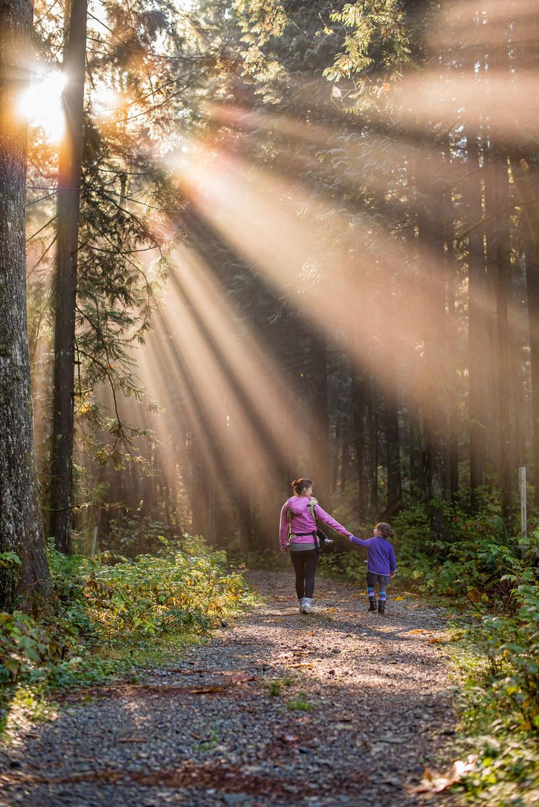
ABOUT SCGC
40+ groups across Simcoe that share a vision for the future
Healthy, equitable communities
Protected greenspaces (GB)
Local climate leadership
Access to clean water, local food
Building community power

Slide 11
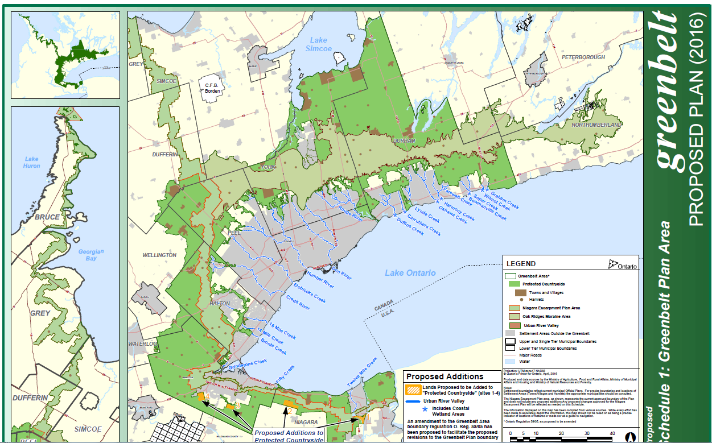
Notes:
Established in 2005
Is the largest one in the world at just shy of 2 million acres
Intended to protect agricultural land, natural heritage, eco-systems and water resources
Is a very popular concept with the public with over 90% of Ontarians supporting the GB and roughly 87% stating that they would like to see it grown (2014 – Environics poll)
David Crombie led a panel in 2015 and released recommendations to the gov’t at the end of 2015 that the GB should be expanded to protect areas of “hydrological significance”. Province is currently looking into how and where to grow the GB. Public comments are due by September 31.

Slide 12
What Does the Greenbelt Do for Climate Change?
$69 Million per year value in pollution removing activity
$379 million per year in flood control costs
$378 million per year in averted damage costs
~87 million tonnes of carbon stored
~200,000 tonnes are sequestered each year
Equivalent to 19 Million cars

Slide 13
What are the biggest threats to Ontario’s Greenbelt?
Politics
Development
Sprawl
Greenbelt highways (413, Bradford Bypass)
Aggregate

Slide 14
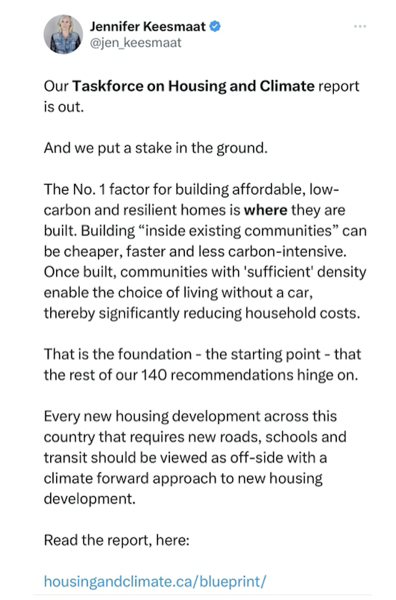
Affordable housing, climate action and environmental protection are related issues. They co-benefit one another.

Slide 15
WHERE IS YOUR POWER MOST CONCENTRATED?
WHO HAS THE POWER TO CHANGE THINGS?
Local politicians including MPPs are easier to access, live in your community, are in your network. Organizing is much easier because it's with people you already know or can access.
Land use policies are created by province BUT municipalities are the ones that implement the rules AND can exceed provincial guidelines.

Slide 16
How Can You Help?
Host information sessions for your congregation for them to understand local issues
Connect with local groups who are doing this work and share their action items, support their efforts, offer low-cost/free space for meetings etc.
Organize your own letter writing campaign to officials, write letters to newspapers about the issue
Review and organize some DIY actions with our support files
Recognize the power of your voice and your community’s voice - that can be used to influence good governance and compassionate decision making

Slide 17
www.SimcoeCountyGreenbelt.ca margaret@simcoecountygreenbelt.ca
Twitter: @margaretprophet @scgreenbelt

Slide 18
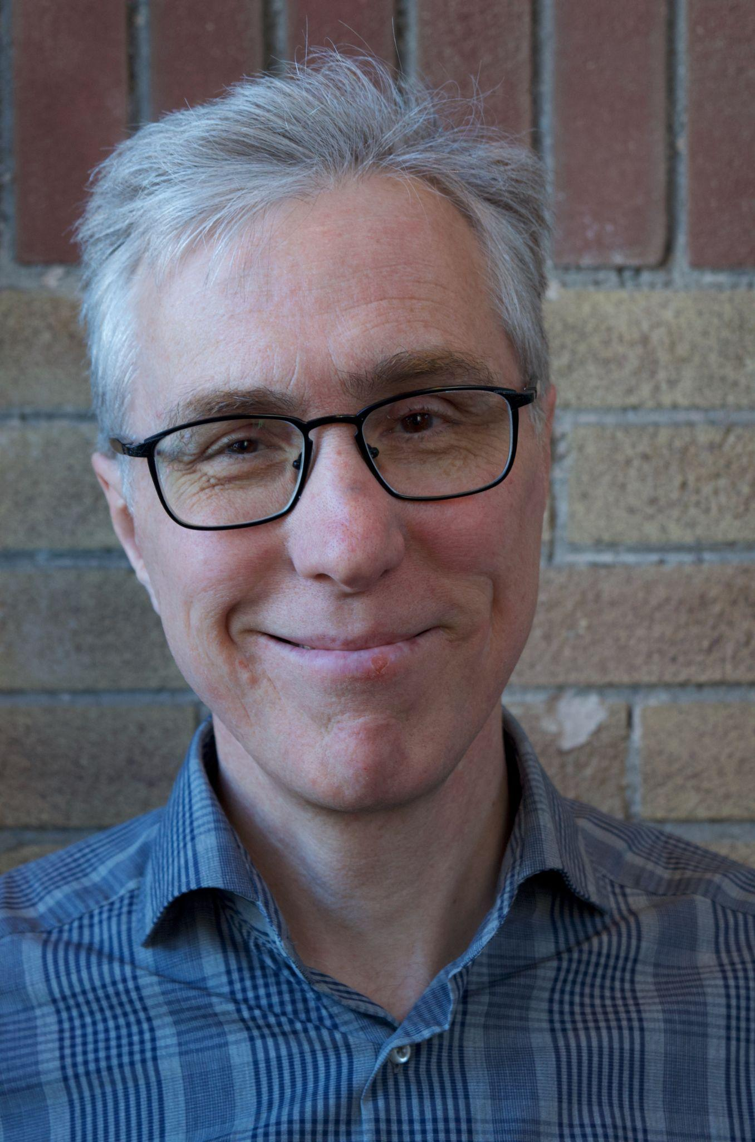
Franz Hartmann - Alliance for a Liveable Ontario
Coordinator for the Alliance for a Liveable Ontario (ALO)
a year-old network of groups and individuals focused on advocating a set of policies that simultaneously solve the housing crisis and protect farmland and natural areas.
Franz Hartmann
PhD in urban environmental policy from York University
Worked for City Councillor Jack Layton as environmental advisor
Past Executive Director of the Toronto Environmental Alliance
Past Chair of the Ontario Greenbelt Alliance and then its Coordinator in 2020.
Notes:
Franz is the Coordinator of the Alliance for a Liveable Ontario (ALO) a year-old network of groups and individuals focused on advocating a set of policies that simultaneously solve the housing crisis and protect farmland and natural areas. Franz has been actively engaged in environmental issues for over 33 years, with a focus on public engagement and policy advocacy. In 1998 he earned a PhD in urban environmental policy from York University and started working for City Councillor Jack Layton as his environmental advisor until 2002. From 2003-6, he worked with Jack in Ottawa leading Jack's civil society outreach. From 2007 and 2018 he was the Executive Director of the Toronto Environmental Alliance. Franz has also been actively involved with the Greenbelt since 2009. and eventually became Chair of the Ontario Greenbelt Alliance and then its Coordinator in 2020.

Slide 19
“Committed To Action”
Presentation by Franz Hartmann, Coordinator
March 9, 2024

Slide 20
“Where we build is fundamental to getting housing right. In fact, the International Panel on Climate Change’s most recent assessment report cites that spatial and land use planning offers high potential to address most of the United Nations’ Sustainable Development Goals (SDGs) and offers the greatest strategy to reduce GHGs from transportation.”
Cherise Burda, Executive Director, City Building TMU
From: https://www.torontomu.ca/city-building/news-research/2024/03/housing-climate-task-force-blueprint/

Slide 21
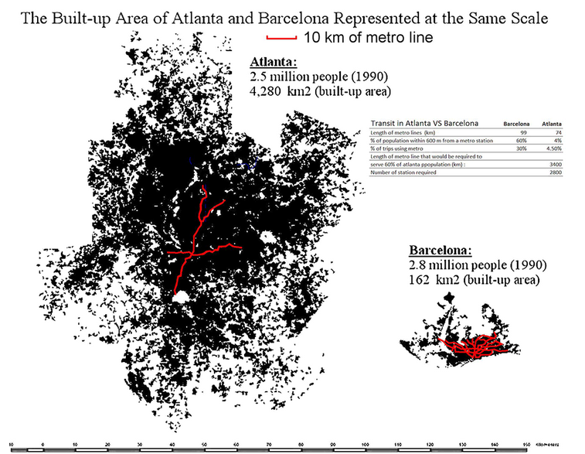
Two Different Approaches to City Building
From: https://usa.streetsblog.org/2014/09/03/wowza-scale-maps-of-barcelona-and-atlanta-show-the-waste-of-sprawl
Notes:
There are two competing visions for how to build our cities.

Slide 22
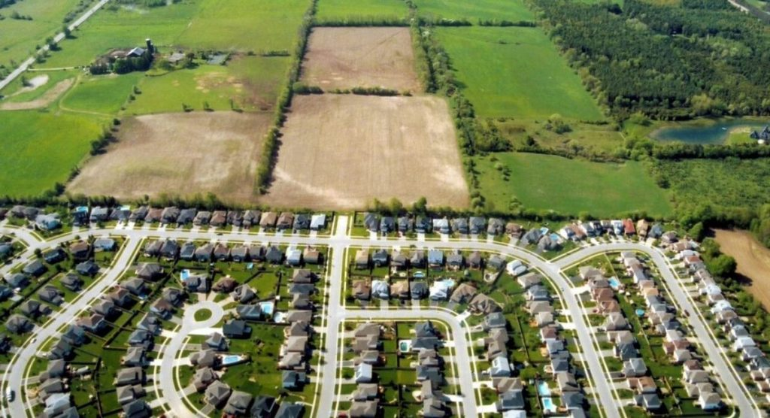
For decades, land speculators, developers and government planning rules have made it easy to push suburban sprawl.

Slide 23
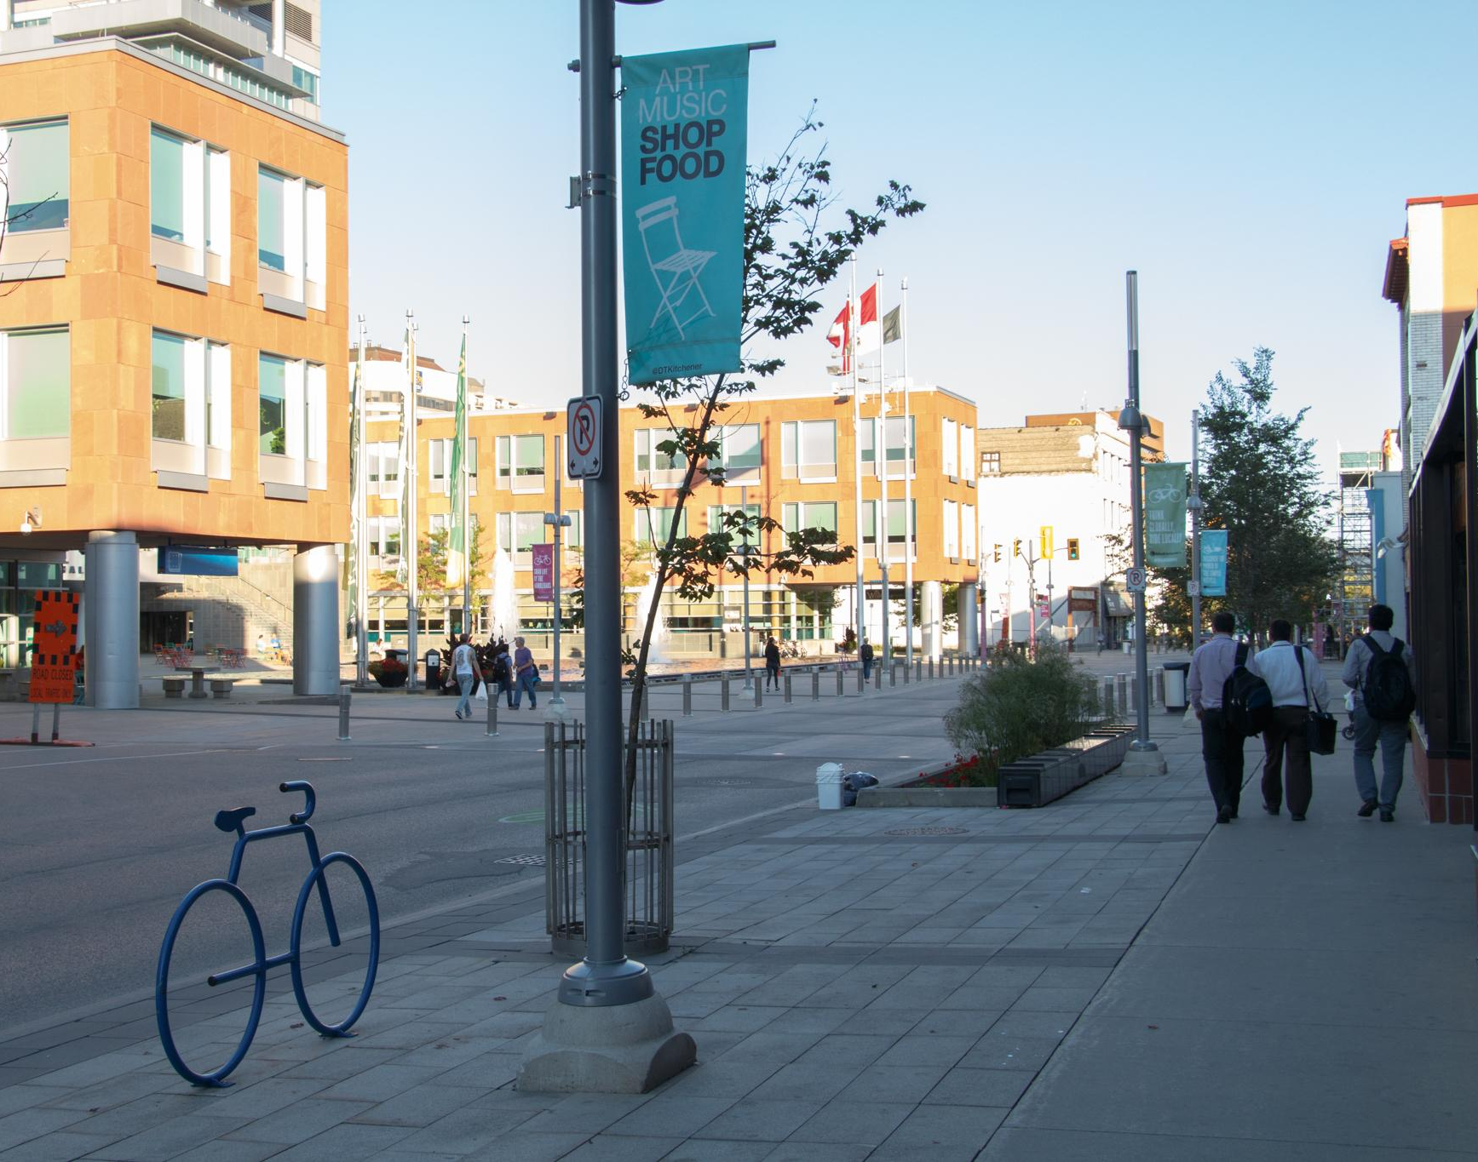
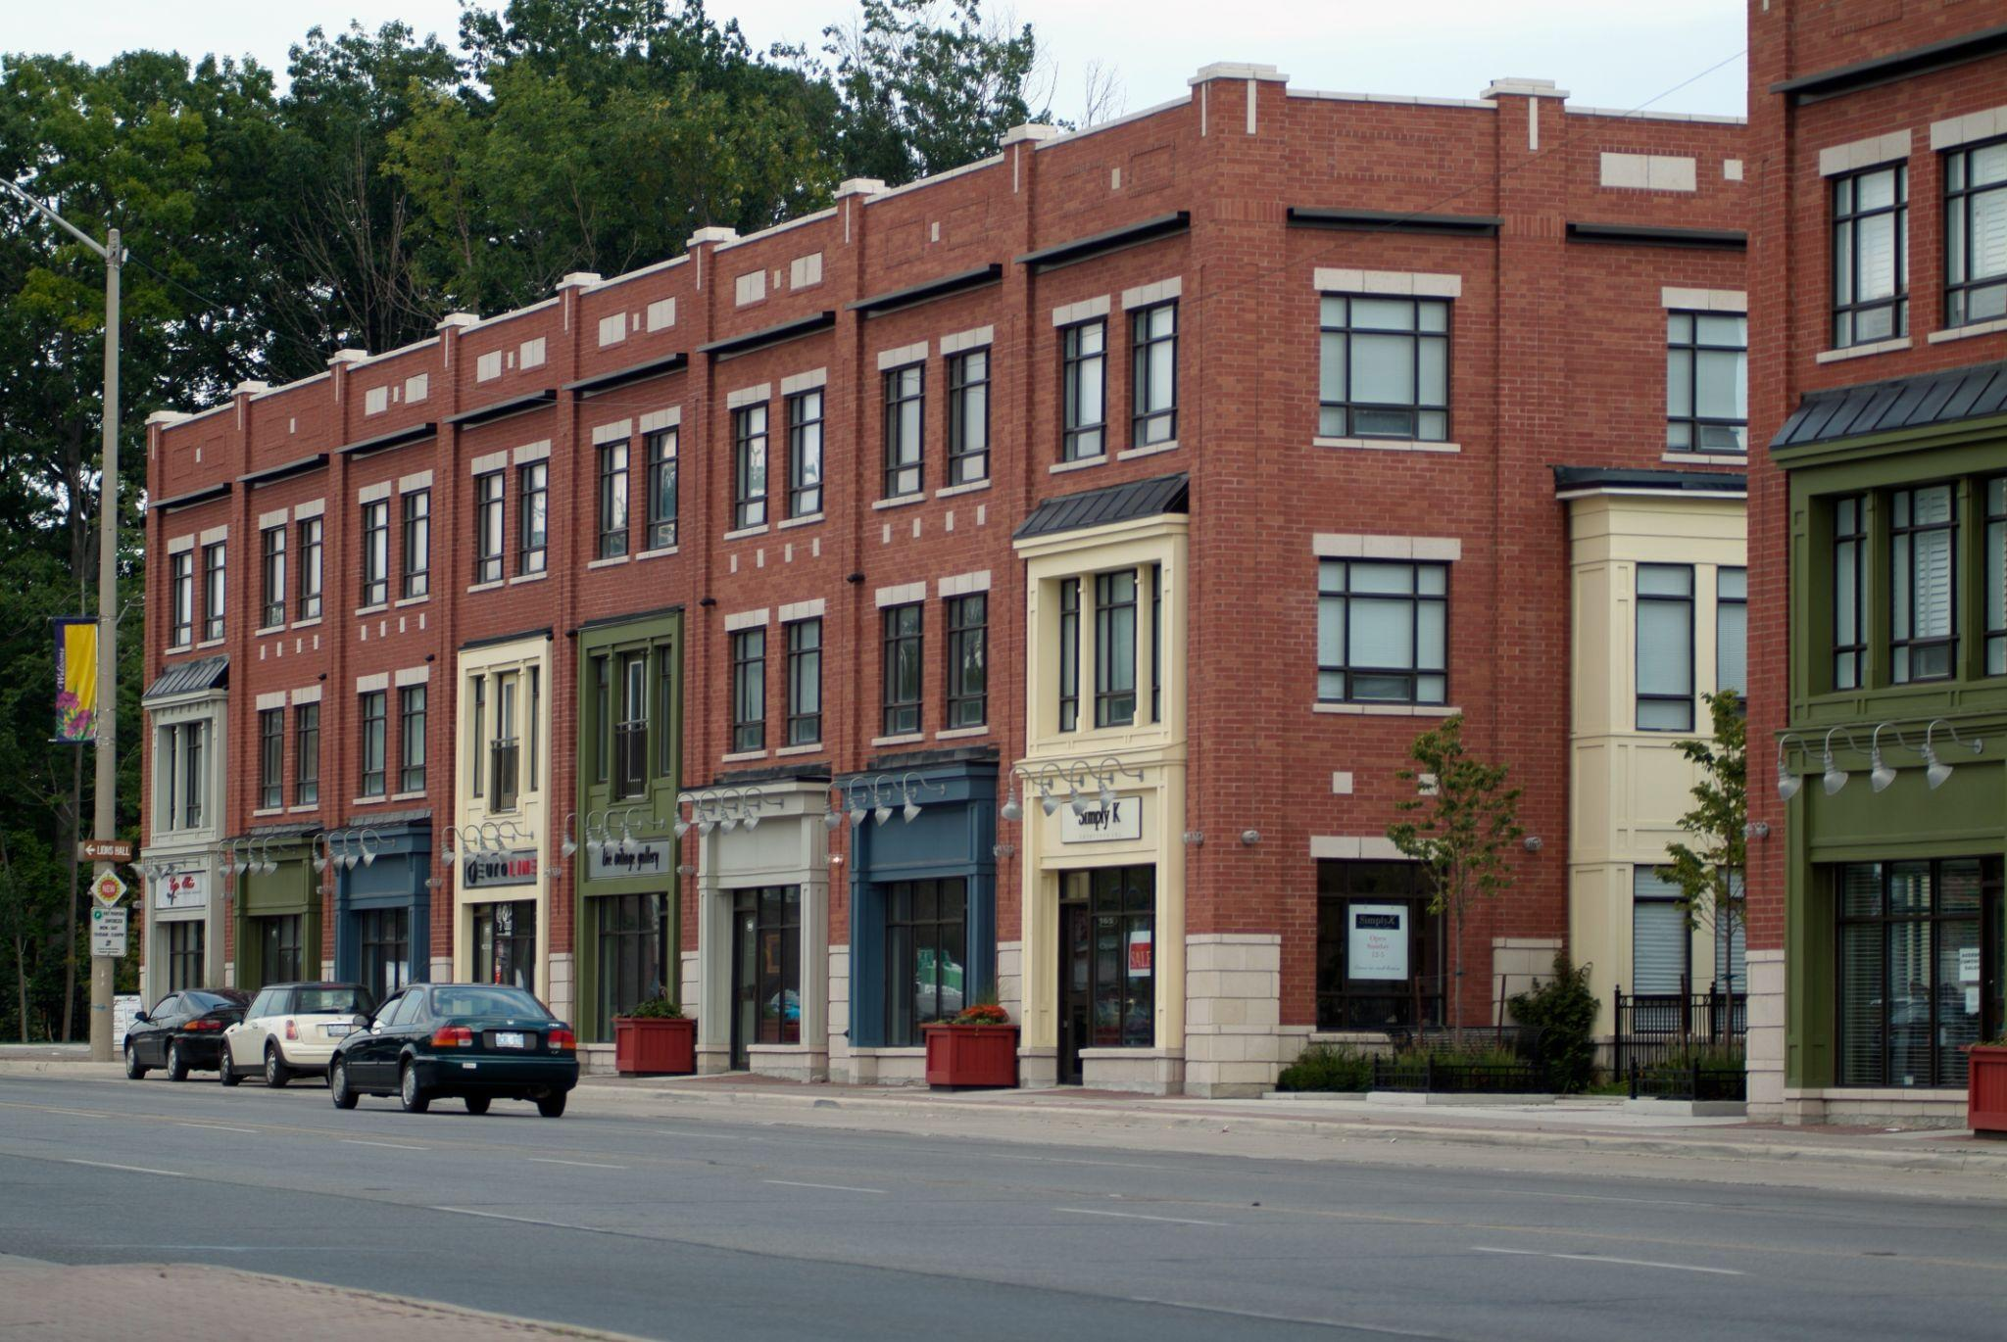
More recently, there has been a push towards building within existing towns and cities (density) and doing so in a way that is sustainable and reduces carbon emissions.

Slide 24
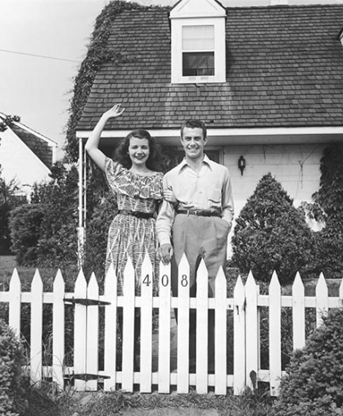
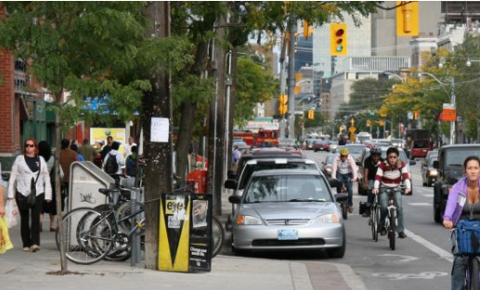
But the fight continues: two Competing Visions
White Picket Fence Sustainable
vs.

Slide 25
The pro-sprawl side claims we don’t have enough land available for building all the housing we need and they suggest we need to sacrifice important environmental protections in order to address the housing crisis.
The evidence makes it clear they are wrong: we have more than enough land already set aside to build all the housing we need.

Slide 26
We can stop sprawl, build sustainable communities that are climate resilient, protect our farmland, wetlands and natural areas and solve the housing crisis.

Slide 27
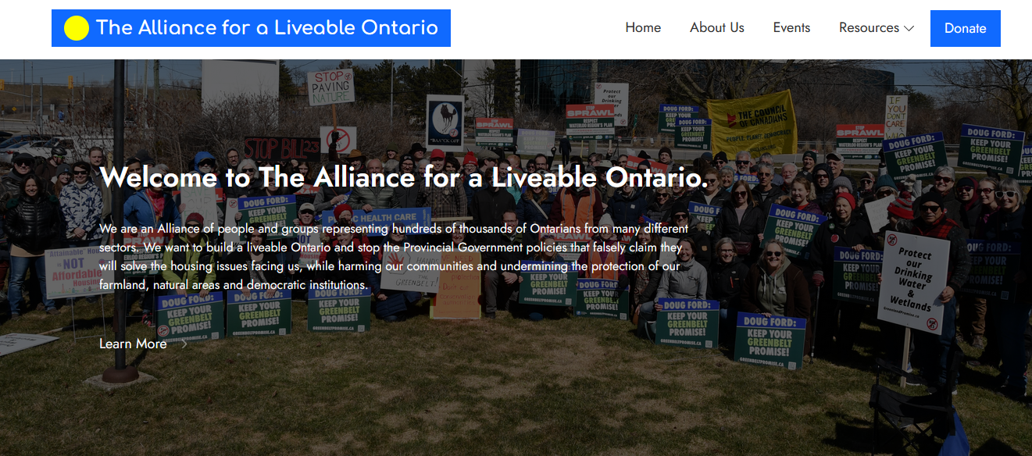

Slide 28
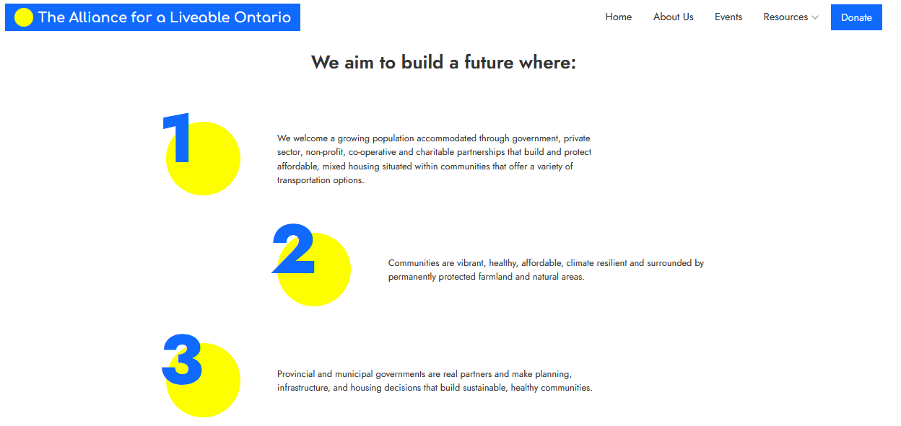

Slide 29
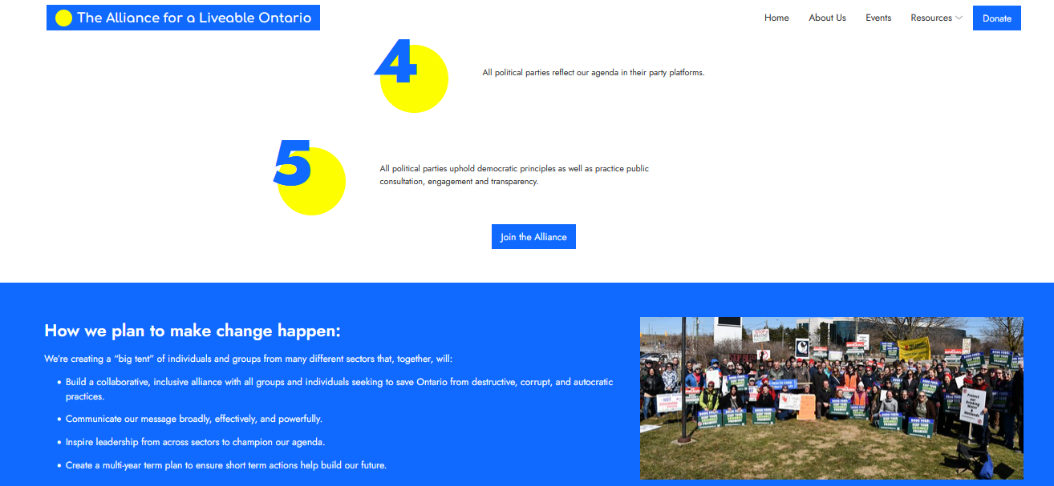

Slide 30
Please join us.
Visit: liveableontario.ca
Thank you.

Slide 31
OUR ASK
We would like you to commit to…
…holding a networking meeting in your church to which you invite
Your mayor
Your Councillors
Your MPP
Your MP
Local
Engineers/Scientists
Contractors
Residents
Photo by Brooke Cagle on Unsplash
The Social and Ecological Justice Commission has funding available to support these initiatives. Applications will be available soon on the Ecological Justice tab of the Shining Water Region site.

Slide 32
Networking Time: 1:45-2:20
From your experience
Share whatever you want
Help us consider other options to harness community energy for ongoing biosphere crises
Help each other solve problems that block community engagement
Photo by Brooke Cagle on Unsplash
Notes:
I will be taking notes during these conversations and those notes will also be available online. If you want state any identifying information you want attached to your words when you speak and I will record that as well.

Slide 33
Your voice is welcomed!
Please email us at with input or question or answers:
Susan Eagle at eagle.susan@ymail.com or
Esther Collier at targetclimatechange@gmail.com
Slideshow and chat notes will be shared on the Justice tab in the Shining Waters Region website, under Ecological Justice.
Thank you for talking about climate!

Slide 34
Next Sessions
April and November 2024
Near Net Zero by 2030?: Heat Pumps and Geothermal Loops
Saturday, April 13, 2023 at 1 p.m. on Zoom
Near Net Zero by 2030?: Financing and Grant-Writing
Wednesday, November 6, 2023 at 7 p.m. on Zoom

Slide 35
Thank you and Farewell

