Slide 5
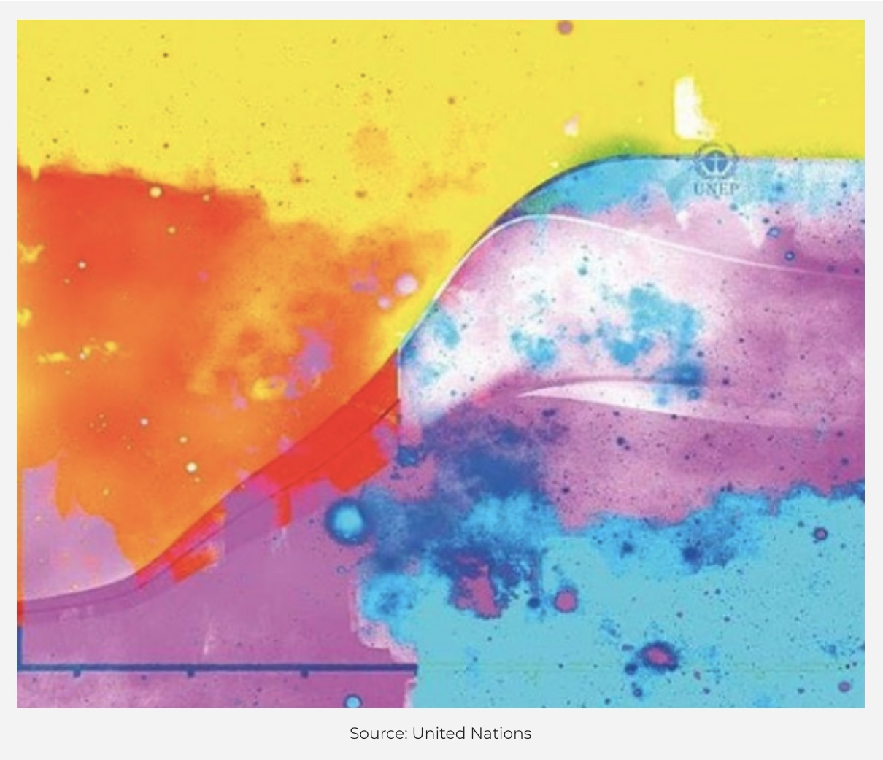
Notes:
Artistic representation of increasing CO2 emissions over the last century, over 380 ppm, from the IPCC.

Slide 7
Near Net Zero by 2030?
Green Design for a Sustainable Future
Notes:
Topics may include: installing renewable energy, adopting electric transportation, green roofs and community gardens, eating vegan
Wednesday, June 21st, 7pm – Near Net Zero by 2030?: Green Design for a Sustainable Future

Slide 8
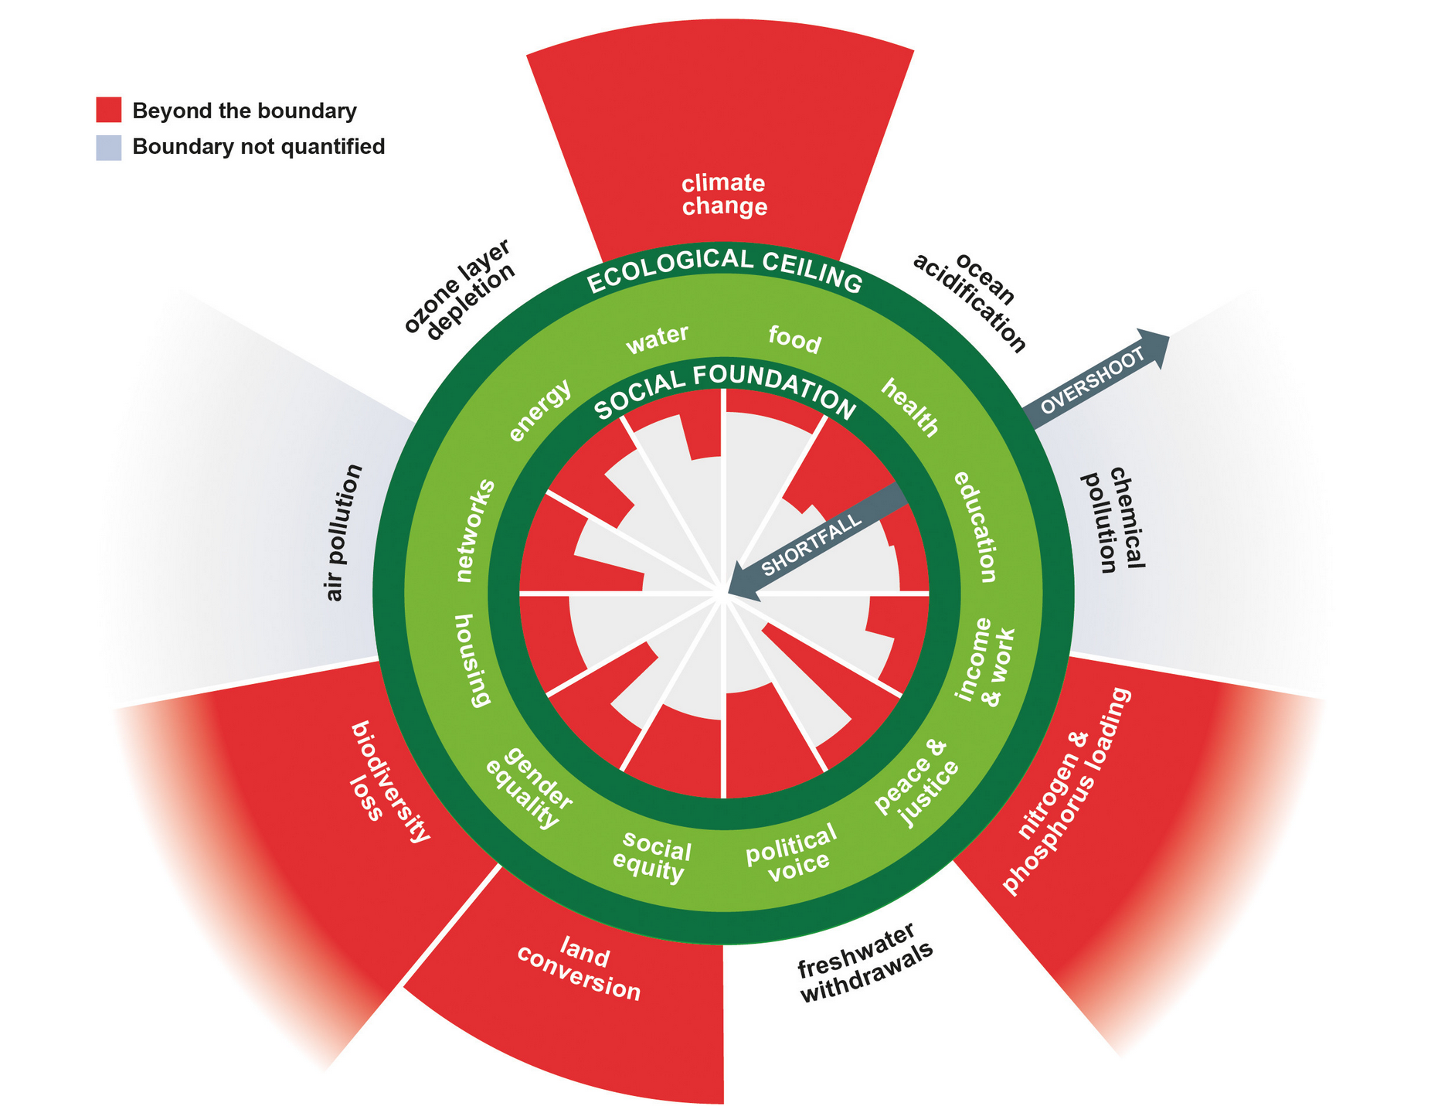
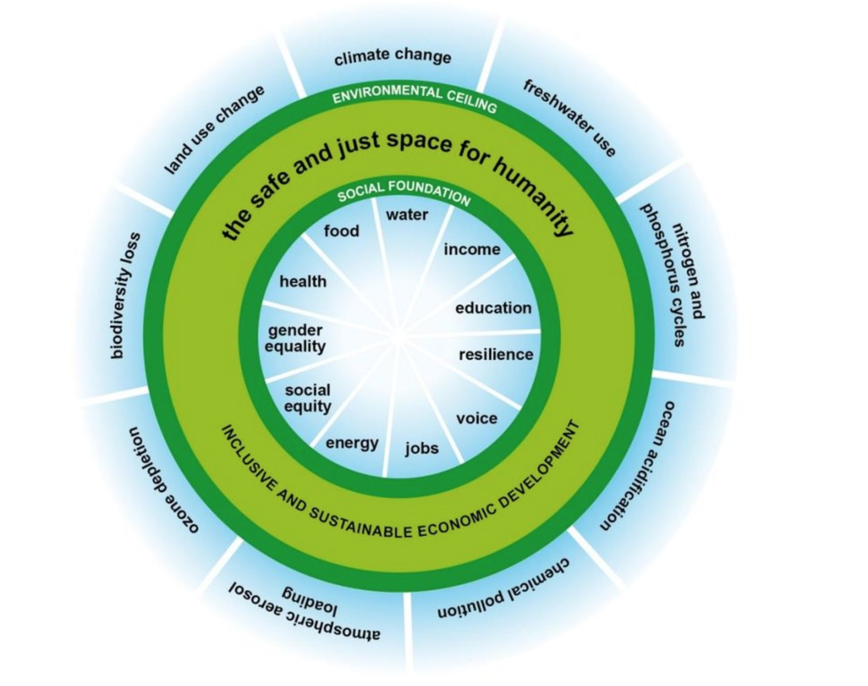
Donut Economics – Planetary Boundaries
Video on Circular Economy by Kate Rayworth
(Rayworth, 2017)

Slide 9
Principles of Green Design & Design for Social Justice
Green Design
Design for Social Justice
If you design within the system, you reinforce inequity
Effective Listening
ID Structural Conditions
Increasing Good
Enhancing Human Capabilities
Life, health, play, interactions with other species
Basic and contextual
Which conditions give rise to inc. human rights?
Opportunities and resources
Counter Cultural
ID Social Groups
Who has been marginalized or ignored ?
Reducing imposed risks and harms
Identify the problems they deem important
Who rights are being augmented?
Sense/imagination/thought, reason, affiliation
Focus on contextual listening
Conserve and improve natural ecosystems while protecting human health
Use life-cycle thinking
Ensure all material & energy inputs/ outputs are safe & benign
Minimize depletion of natural resources
(Leydens et al., 2014)

Slide 10
The Design Process
1) Listen Carefully
2) Define the Problem
3) Brainstorm solutions
4) Choose a direction which will maximize:
Human rights
Justice
Sustainability
Opportunities and resources
5) Prototype & Iterate
6) Scale

Slide 11
Case Studies
Green Design for a Sustainable Future
Notes:
Topics may include: installing renewable energy, adopting electric transportation, green roofs and community gardens, eating vegan
Wednesday, June 21st, 7pm – Near Net Zero by 2030?: Green Design for a Sustainable Future

Slide 12
Case Study 1: Pricy Peaches
Jane is a regular church goer, aged 70, whose husband has recently passed away. Now has had to move into a small condo, and will be surviving on her CPP.
One day, while she was grocery shopping, Jane noticed that with inflation a single jar of peach jam costs nearly $10. Back in my youth, she thinks, my mother and I used to can hundreds of jars of jam on the farm, plenty for the whole year and extra for Christmas presents. She briefly thinks of the nice big canning pot in the kitchen supply store, but realizes that it would cost her well over $150 to get all the equipment – not to mention that she has no room for big pots in her small condo.
Oh, well, she thinks, I’d better just buy this jar of jam and only eat it on weekends. At home she savors the jam, and when she is done, she meticulously washes out the glass jar and tosses it in the recycling bin.
Challenge: Redesign this situation through a design for social justice and green design lens.

Slide 13
Case Study 2: Travel Trouble
Anisa and Parsa already use sustainable options for local travel and commuting. However, they love to canoe and hike in locations that are only accessible by road.
They would like to buy an electric vehicle, but are worried about finding charging stations close enough to remote areas, and also wonder if that is the most sustainable choice when it comes to vacations.
Challenge: Redesign this couple’s vacation through a design for social justice and green design lens.

Slide 14
Case Study 3: Everywhere Events
Tonya helps people in a long-term care home near her. Often, she is is charge of events that connect families with loved ones in other countries for holiday events. She thinks a hybrid virtual/in-person option is possible.
Hearing is an issue for some people, and she is wondering how to keep both the in-person group and the hybrid group participating in the event.
Challenge: Improve the design of these events through a design for social justice and green design lens.

Slide 15
Breakout Rooms
Consider Case Studies
and Discuss Possible Solutions
in Small Groups
Notes:
Topics may include: installing renewable energy, adopting electric transportation, green roofs and community gardens, eating vegan
Wednesday, June 21st, 7pm – Near Net Zero by 2030?: Green Design for a Sustainable Future
Note: have slides as separate .pdf files which I can drop in the chat for each breakout room.

Slide 16
Green Power

Slide 17
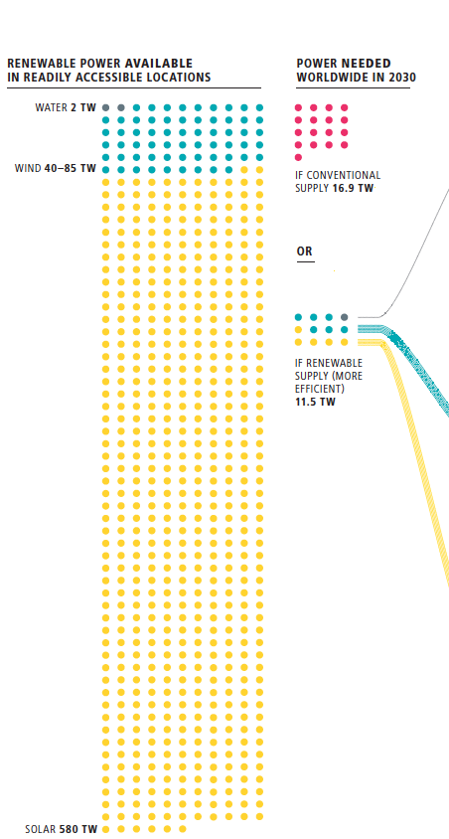
Renewable Energy Supply
Loads of untapped locations both locally and globally
Need a mix of WWS (wind, water, solar) at both large and small scales (such as on the church)
Spin off benefits such as less of air pollution and ensuing health costs
(Jacobson and Mark A. Delucchi, 2009)
Notes:
Cite Jacobson and Dellucci Article in 2009

Slide 18
Energy Efficiency & Energy Conservation
Programmable timers
Energy Star appliances
Energy efficient lightbulbs
Smart power strips (phantom power)
Clean heater & AC filters regularly
Sweaters
& blankets
Right size burner
Full loads
Air dry
Inc. fridge
temp
Bake with ceramic & lower temp
Notes:
Last session was on church retrofits for reduced power use – insulation is huge, but also

Slide 19
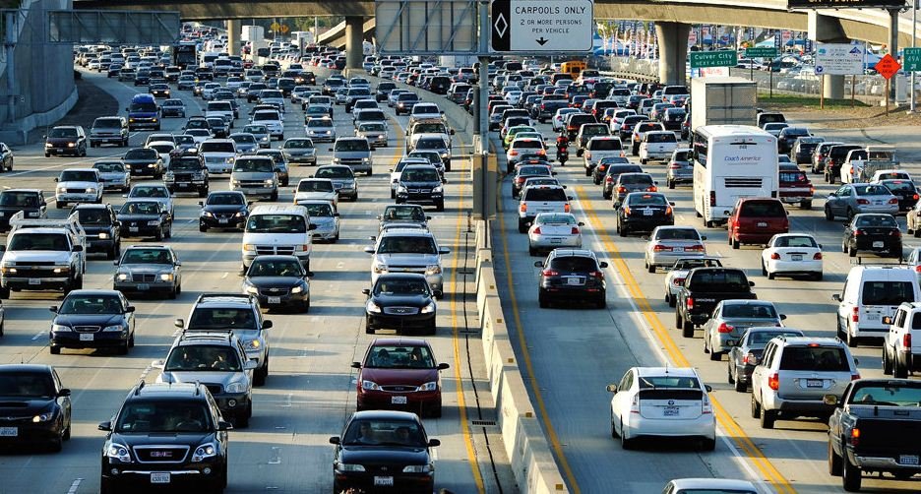
Transportation
The problem

Slide 20
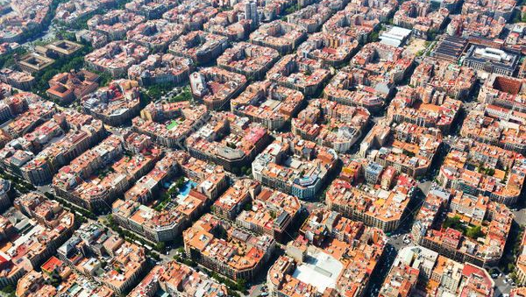
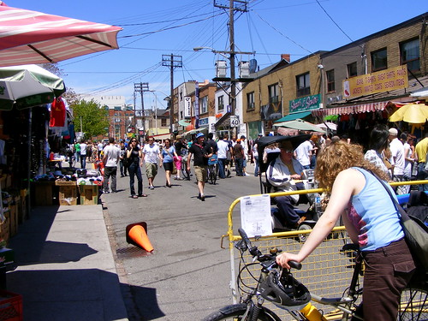
Transportation
Example: Barcelona Super Blocks
CarShare (Enterprise, Uber Pool, Zip Car) & Electric Scooters
Biking, Rollerblading, Skateboarding, etc.
Group Transit - Subways, busses, GO Train, streetcars, etc.
Walking, jogging, wheelchair wheeling
Hybrid and Virtual Meeting Alternatives

Slide 21
Waste Management
Notes:
Reduce, reuse and recycle
Waste management systems

Slide 22
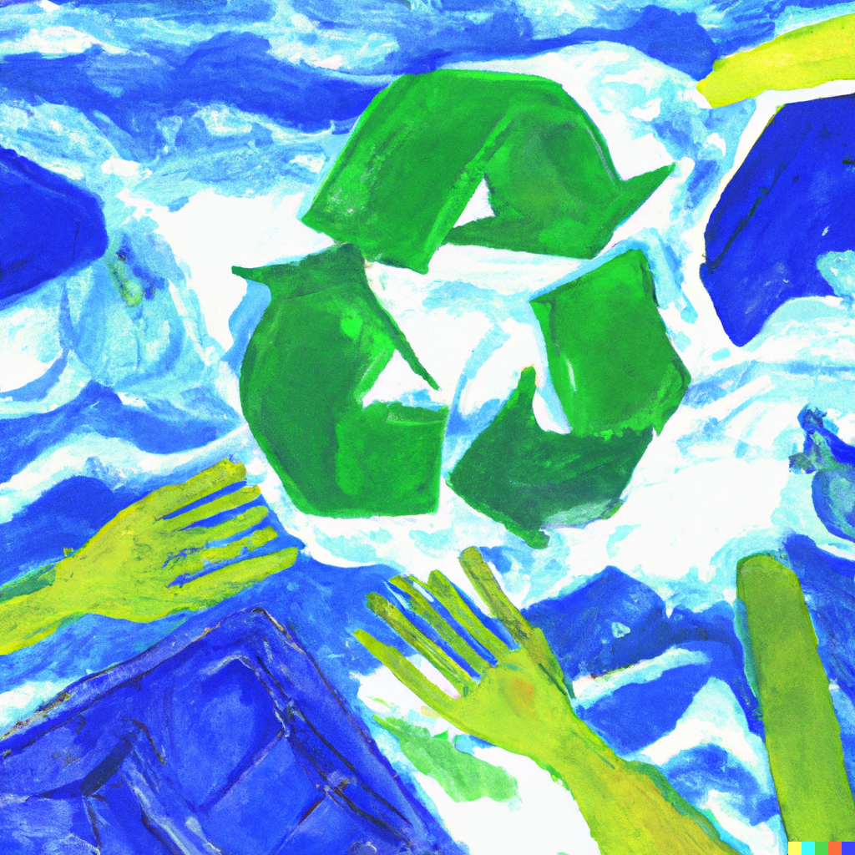
Waste Diversion
Improving Recycling & Composting
Increased Diversion
At home
In public spaces
Small businesses and organizations
Improved Processes
municipal programs
chemical processes
Interesting example:
Researchers crack the code for economically turning plastic waste into fuel

Slide 23
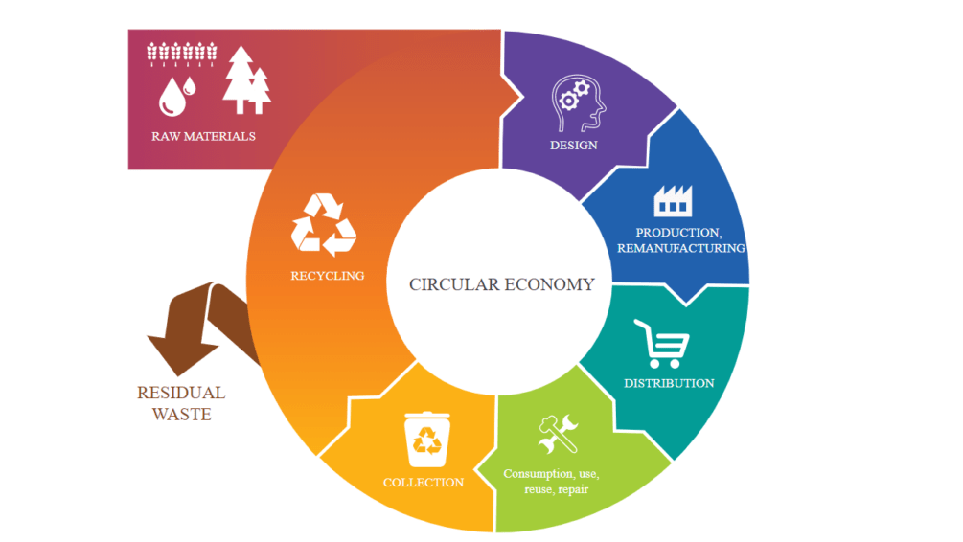
Circular Economy
Product Design

Slide 24
Circular Economy - Examples
Return
of the Milkman
Loop (Loblaws) – brands from Haagen-Dazs to Heinz
Local soap and food refill shops (Saponetti, food co-ops such a Karma, Lush “Naked” Products)
Grocery bin delivery services (Fresh City Farms, Mama Earth Organics, FoodShare)
Reusable Diaper Services (Wonderwear Modern, Comfy Cotton, Happy Baby)
Tackling Takeout
Reusable coffee mugs (some stores give discounts)
Reusable containers – something to watch (LetsGoZeroWaste, Friendlier)
Fix it First
Do you know where your local cobbler is? (Sandalman, Sole Survivor)
How about toys and gadgets? (Repair Café)
Church sewing and quilting groups are awesome at this!
Upcycling
Park benches from recycled plastic (SUNPERK)
Coats and sunglasses from old fishnets (Wuxly, Costa del Mar)
Terrific scope for DIY arts and crafts from coat hooks to planters…
Better to Borrow
Libraries are not just for books (Tool Library, The Kitchen Library)
Jeans for rent and recycle (MUD Jeans)
Furniture, applicates, electronics – comes with repairs (Rental City)

Slide 25
Next Steps
Near Net Zero by 2030?! : Harnessing Community Resources
Saturday, November 4, 2023 at 1 p.m. on Zoom
Save the Date!
Our “Ask”:
Hold info sessions in your own congregations to activate your communities potential, and let us know how it goes!
Option 2
– hold a design session –
reach out to ESJ for resources

Slide 26
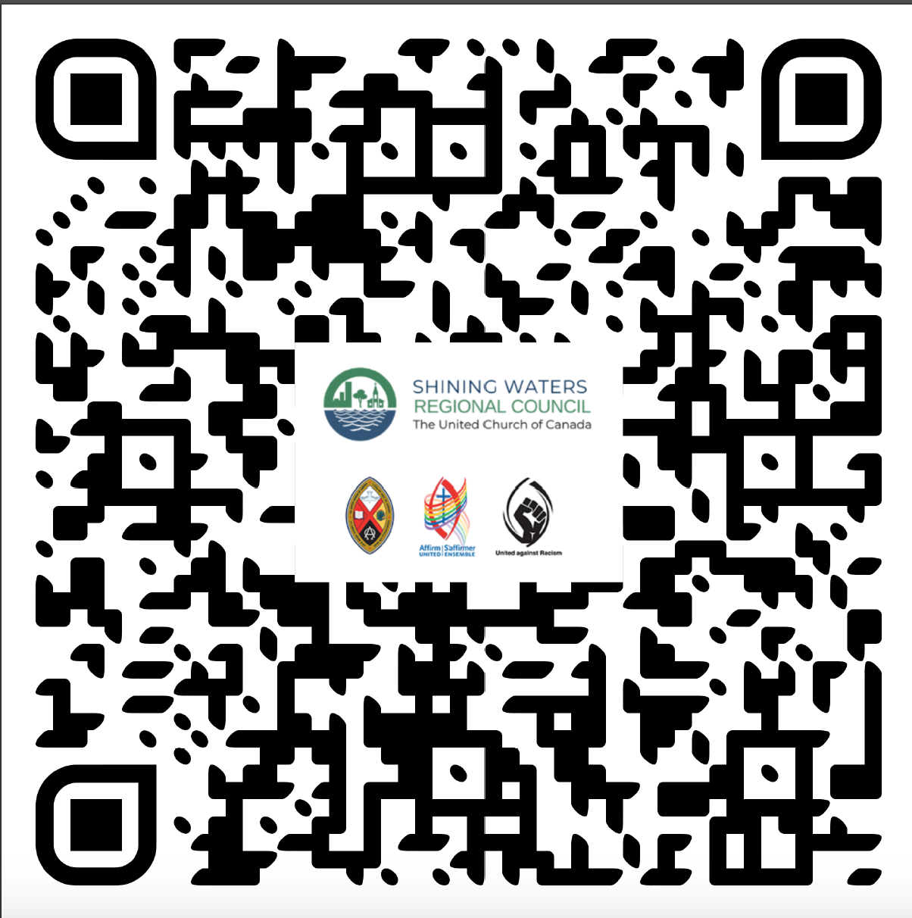
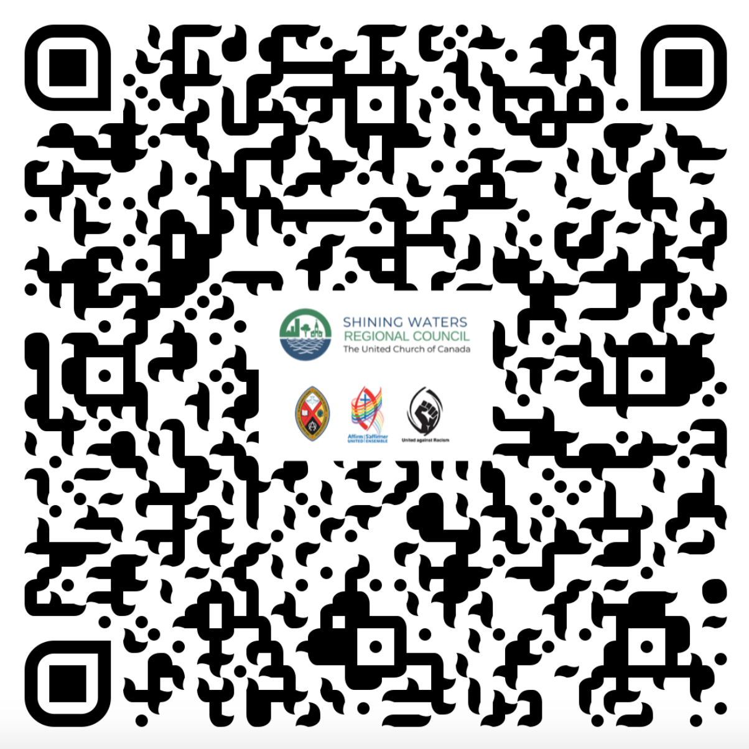
Share your Progress with the SEJ Commission!
Planning Template for an Info Session
Share your Church’s Ecological Goals

Slide 27
Resources Cited
Rayworth, Kate. “The Doughnut of social and planetary boundaries”, 2017.
For more info: Video on Circular Economy by Kate Rayworth
Leydens et al. “What is Design for Social Justice?”, 2014.
Jacobson, M. and Delucchi, M. “A path to sustainable energy”, Nov 2009. Retrieved from: https://www.scientificamerican.com/article/a-path-to-sustainable-energy-by-2030/

