Slide 1
Search Team Equity Training
Shining Waters Regional Council

Slide 2
Equity Training Goal
To identify and address our biases so that search team members are open to the skills and gifts of every prospective minister in the pastoral relations process.
Notes:
When you read that goal statement, what personal reaction do you have?

Slide 3
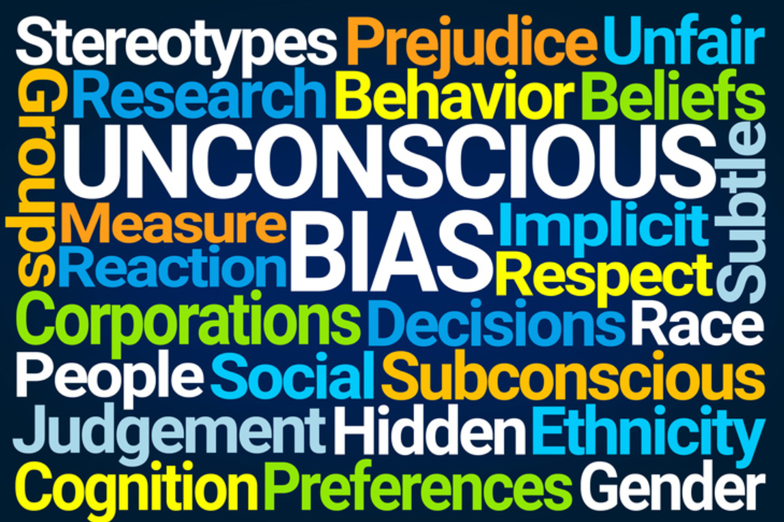
Are you biased?

Slide 4
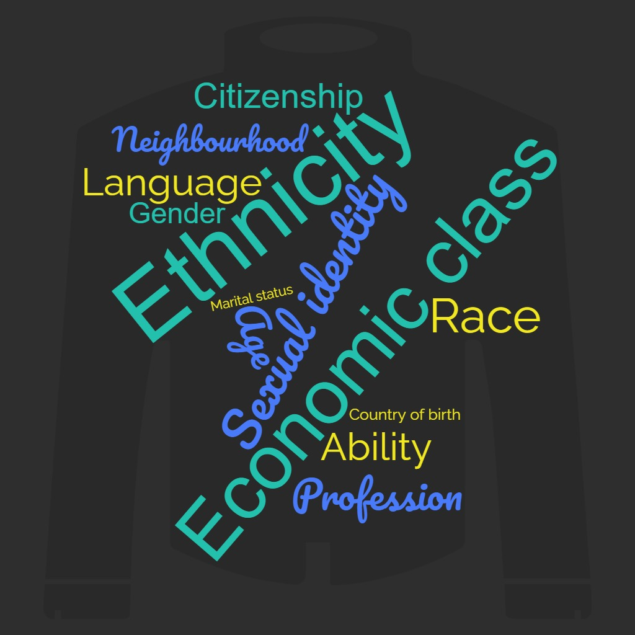
Power Analysis

Slide 5
Privilege and Non-privilege
Privilege | Non-privilege
Normative | invisible; deviant; unnatural
Rights – service; safety; respect | Lack of rights – lower quality of service; harassment; insecurity
No awareness of privilege | Daily awareness/reminders of non-privilege
Power conferred/granted | Margins of power. Access is difficult.
Easy to see self in culture/entertainment | Disconnect with dominant culture; self not reflected
Open doors- jobs; education | Doors are closed and hard to find

Slide 6
Type of Bias
Motivational | This bias occurs when the interviewer is motivated to obtain a particular kind of outcome.
Confirmatory | We hold prior information. We tend to notice and favour things that confirm the ideas we already hold rather than notice or favour things that contrast with our ideas.
Cognitive | A cognitive bias is a subconscious error in thinking that leads you to misinterpret information from the world around you, and affects the decisions and judgements you make.
Observational | Observational bias is based on our life experiences. It involves what we observe in other people. We all tend to observe some physical attributes more than others and to ascribe more value to these observations.
Notes:
Give examples of each.

Slide 7
How might a search process bias against some ministry personnel?
Search steps
1. Developing your position description and Living Faith Story
2. Putting together your search team
3. Recruiting through advertisements
4. Searching ministers’ profiles
5. Shortlisting and choosing your interviewees
6. Interviewing
7. Discerning and choosing your candidate for recommendation
8. Presenting your recommendation to the congregation

Slide 8
Racial bias (racism) and the church
How open are you to a minister whose skin colour/racial identity is different from your own, and/or different from the majority of congregants?
Stretching Beyond Racism on Vimeo

Slide 9
Our challenge:
How will you ask each other hard questions about your biases in a way that is compassionate, respectful, and open to the possibility of mutual transformation?
What commitments do you want to make to each other as a search team when it comes to equity issues and your search?

