Slide 1




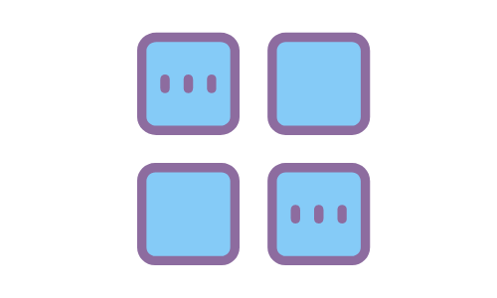



Participant Orientation
Audio + Video
Chat
Help
Breakout Rooms
Live Captioning
Recording
Notes:
Welcome to our online meeting. I’m going to review the tools we will use in our gathering today.
Audio + Video – please keep your microphones muted and your videos off unless you are speaking
Help – if you need technical support you can chat with X in the chat, they have added “HELP” in front of their name; or you can email X at this address (posted in the chat)
Phone Participants – If you are participating by phone, the pressing the keys *9 raises your hand and *6 mutes and unmutes your microphone.
Chat - Open the chat box by clicking the icon on the Zoom toolbar. You can drag it around on your screen if you like, that only changes the view for you. If you have it closed the chat you will see a little notification number on the toolbar when there are unseen messages there. In this meeting … (explain how you are using the chat). For example, we have limited the chat in this meeting so that you can only chat to cohosts as a way to minimize distractions and in order to use the chat as a tool to facilitate the meeting. Everyone please open the chat box now. At the bottom of the box there is a label after where it says TO: where you can choose the recipient of your message. Right now you can only see the list of co-hosts, who have renamed themselves to include the role they are playing at this meeting, help, vote, etc. When the chat is completely open you will see the option to chat to Everyone, or privately to one particular participant in the meeting. Remember that after you type in what you want to say in the message box, you have to hit enter on your computer keyboard to send your message.
If at some point during the meeting you wish to raise a point of order, please raise your hand and type PT OF ORDER in the chat box and send that message to <cohost>. <Cohost> can you type that in so we can see it please, and the Chair will adjust the speakers accordingly. If you are on the phone, you may raise your hand for a point of order by pressing *9. You can save the meeting chat by selecting the three dot menu in the bottom right of the box and choosing Save Chat. Zoom will create a folder on your computer with the notes.
Breakout Rooms – We will be using breakout rooms for small group discussion. You will be put in a room automatically/or you will choose your own room. If you do not wish to join a group, turn your camera off and you may wait in the main meeting room with your microphone muted.
Live captioning – there is an automated captioning feature in Zoom that is not 100% accurate but it does a reasonable job. Turn it on with the icon on your toolbar.

Slide 2


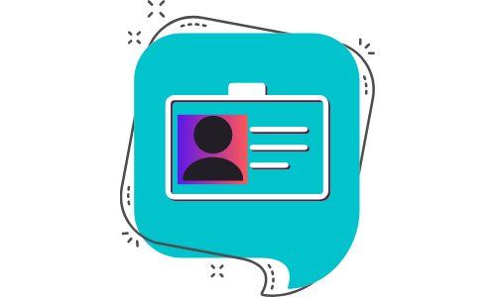



Participant Orientation
Participants Panel
Raise Your Hand
Your Name
Second Voter
Polling
Email Vote
Notes:
Customize the script and the slides to suit your meeting plans. Here’s a sample script. Each line is set to ‘fly in’ animation upon mouse click.
Welcome to our online meeting. I’m going to review the tools we will use in our gathering today.
Participants Panel – Open the Participants Panel with the icon on your Zoom toolbar. Click on it and notice it open and close, on a panel to your right, if you’re viewing on a computer. Here is the list of everyone who is attending today. You should see your name at the top of the list and then the host’s name and then the names of people who are unmuted float to the top.
Name and pronouns – You can rename yourself by hovering your mouse over your name on the Participants Panel, click on More and select Rename. Type in your name. We invite you to add your pronouns that express your gender identity here, or add the phonetic spelling of your name in a bracket if you wish. (Add voting instructions here; for example, corresponding members add a Z in front of your name so it moves to the lower part of the list which will make it easier for scrutineers to count. ) If you are joining the meeting by phone a cohost will help you rename yourself on the screen.
Polling – We will use polling in this meeting for our voting.
Raise Your Hand– To add your name to the speakers list raise your virtual hand at the bottom on the Reactions icon on the Zoom toolbar. Don’t ’wave or raise your real hand. Try that now. Cohosts are monitoring the panel and will keep the Chair informed of the list of speakers as you come forward. When the Chair calls on you, unmute your microphone and you will have <90 seconds> to speak. You don’t need to lower your hand we will do that for you. Give it a try and see how it looks. If you are participating on the phone raise your hand by pressing *9.
Voting – We will also use the raise your hand feature (or the polling feature) to vote.
Second Voter -- If you have a second voter on the same account today one of you can vote by raising a hand (or a poll) and the other in the chat. There will be a separate round of voting for those who are participating on the phone and you will be asked to use *9 to raise your hand at the appropriate time. Don’t worry about lowering your hand, we will do that for you.
Email – vote. Explain the email voting option if you choose to add that route.
Note: When the host shares their screen with a proposal, the program may put you into full screen mode and you might lose the chat and participant panels. To get these back click 'Chat' and 'Participant' on the Zoom toolbar (usually at the top of your screen when sharing is turned on). They will reappear in the centre of your screen but you can move them to the side by clicking on the top of the pod and dragging it over.

